Slide 1
ROBOTICS
Robot Programming

Slide 2
Robot Programming
Content:
Introduction
On-line programming
Concepts
Teach-in
Playback
Sensor function
Off-line programming
What is an off-line programming?
Arguments for an off-line programming
Programming levels
Summary

Slide 3
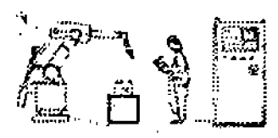
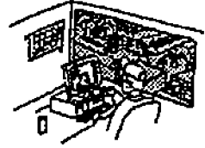
Introductory review
From the
definition:
The industrial robot is an automatically controlled
freely programmable, multifunctional manipulator
with three or more programmable axes, for
Industrial applications in either a
fixed or mobile platform, can be used.
Freely programmable: programmable movements
or auxiliary functions without physical
amendment to be changed.
Robot programming
On-Line
Off-Line

Slide 4
Robot Programming
Programming is the identification and specification of a series of basic actions which, when executed in the specified order, achieve some specific task or realize some specific process.
Robot Programming is the defining of desired motions so that the robot may perform them without human intervention.

Slide 5
Review: Some Definitions
DoF: The degrees of freedom [degrees of mobility] of the robot will be numbered as q₁, q₂, q₃ etc.
  Usually industrial robot arms have between 4 and 6 degrees of freedom, one at each joint.
End-effector: The end of the robot arm, where the gripper or other tool that the robots uses is located, we will define as the end-point (P_{e}) of the robot.

Slide 6
If, for example, the robot has a two finger gripper, to pick things up with, we usually define P_{e} to be a point between the two fingers, so that when this point is geometrically inside some object to be picked up, all the robot has to do is to close the fingers of its gripper to grasp the object. It can then move away with the object between its fingers.
P_{e}

Slide 7
Pose: both the position of P_{e} in space, and its orientation
  It is not sufficient for P_{e} just to be defined as a point, we also need to attach or (conceptually) fix a coordinate system to it, so that we can define both the position of P_{e} in space, and its orientation (together they define the object pose).
P_{e}
P_{e}

Slide 8
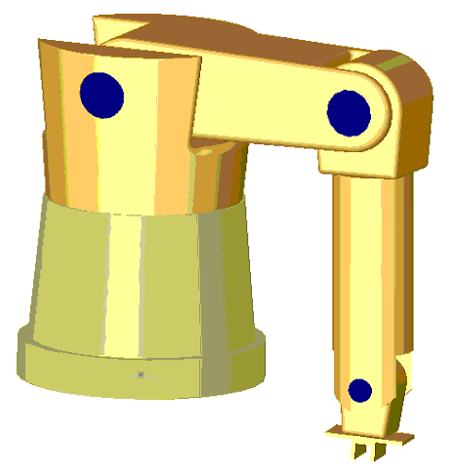
Base Frame: The position and orientation of P_{e} must be defined with respect to some global frame of reference, some global coordinate system. For this we usually use a frame of reference fixed to the base of the robot, which should not move.
  NOTE: The position and orientation of P_{e} in the work space of the robot are determined by the values of the joint positions of the arm—q₁, q₂, q₃,etc.
Notes:
We will see more about all this when we look at coordinate systems and the kinematics of robot arms. For the moment, what is important is that we understand what P_{e} is, and that its position and orientation in the work space of the robot are determined by the values of the joint positions of the arm—q₁, q₂, q₃,etc.

Slide 9

Configuration: Any particular position and orientation of P_{e} in space, and so any particular set of joint values, is called a configuration of the robot arm.
Notes:
We will see more about all this when we look at coordinate systems and the kinematics of robot arms. For the moment, what is important is that we understand what P_{e} is, and that its position and orientation in the work space of the robot are determined by the values of the joint positions of the arm—q₁, q₂, q₃,etc.

Slide 10
Robot Programming Revisited
Robot Programming is the defining of desired motions so that the robot may perform them without human intervention.
  identifying and specifying the robot configurations (i.e. the pose of the end-effector, P_{e}, with respect to the base-frame)

Slide 11
Introductory review
From the
definition:
The industrial robot is an automatically controlled
freely programmable, multifunctional manipulator
with three or more programmable axes, for
Industrial applications in either a
fixed or mobile platform, can be used.
Freely programmable: programmable movements
or auxiliary functions without physical
amendment to be changed.
Robot programming
On-Line
Off-Line

Slide 12
Robot Programming Methods
Offline:
  write a program using a text-based robot programming language
  does not need access to the robot until its final testing and implementation
On-line:
  Use the robot to generate the program
    Teaching/guiding the robot through a sequence of motions that can them be executed repeatedly
Combination Programming:
  Often programming is a combination of on-line and off-line
    on-line to teach locations in space
    off-line to define the task or “sequence of operations"

Slide 13
On-Line/Lead Through
Advantage:
  Easy
  No special programming skills or training
Disadvantages:
  not practical for large or heavy robots
  High accuracy and straight-line movements are difficult to achieve, as are any other kind of geometrically defined trajectory, such as circular arcs, etc.
  difficult to edit out unwanted operator moves
  difficult to incorporate external sensor data
  Synchronization with other machines or equipment in the work cell is difficult
  A large amount of memory is required

Slide 14
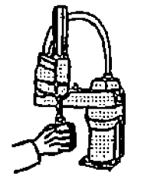

On-Line Programming
On-Line
TEACH-IN
PLAY-BACK

Slide 15
Teach-In
Task: transfer of appropriate programs in the robot controller
The robot is along certain trajectories through the two conducted manually with
the both the robot and its movement and other devices in the robot cell monitored
closely.
Teach-in Process:
Teach
Starting from
points
and save
Edit
Addition of
Commands for the
Automatic operation
Control
Gradually,
Next,
backward
Correct
Starting from
points
and again
save
Perform

Slide 16
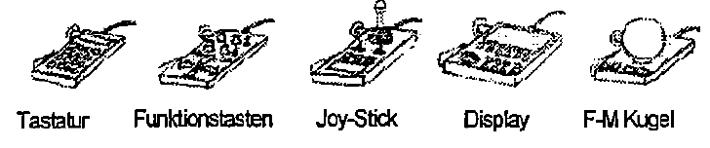
Teach pendant
PHG-types to a Teach-In program:
Keyboard
Function keys
Features:
- To enable long cable to a good view
- Emergency stop switch
- Enabling switch
- Selection of TCP (Tool Center Point) function
- Selection of the coordinate
- Range of motion mode
- Selection of the speed of movement
- Status Display

Slide 17
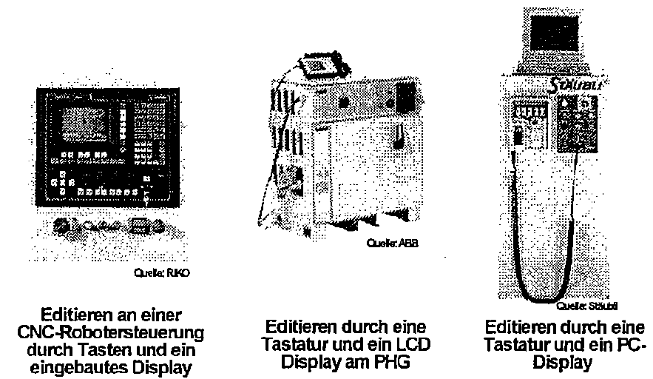

Control Equipment
Types of robot-Program:
Source: ABB
Source: RIKO
Editing on a CNC robot controlled by buttons and a built-in display
Editing by a keyboard and an LCD display on PHG
Source: Stäubli
Editing by a keyboard and LCD display
TEMPUS IV Project: 158644 – JPCR
Development of Regional Interdisciplinary Mechatronic Studies - DRIMS
ROBOTICS

Slide 18
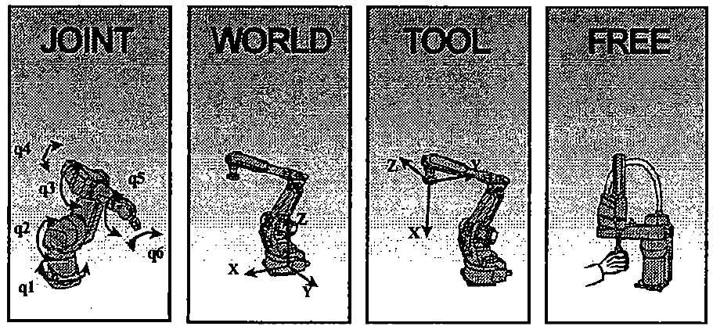
Teach-in coordinate systems
JOINT
WORLD
TOOL
FREE
TEMPUS IV Project: 158644 – JPCR
Development of Regional Interdisciplinary Mechatronic Studies - DRIMS
ROBOTICS

Slide 19
On-Line/Teach Box
Advantage:
  Easy
  No special programming skills or training
  Can specify other conditions on robot movements (type of trajectory to use – line, arc)
Disadvantages:
  Potential dangerous (motors are on)
TEMPUS IV Project: 158644 – JPCR
Development of Regional Interdisciplinary Mechatronic Studies - DRIMS
ROBOTICS

Slide 20
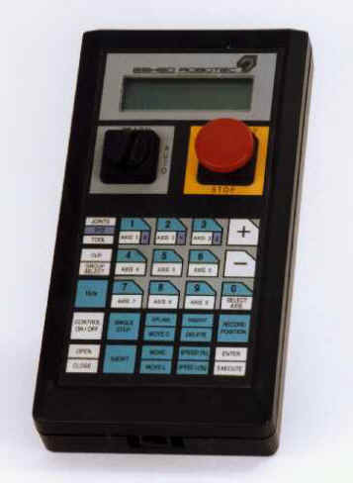
TEMPUS IV Project: 158644 – JPCR
Development of Regional Interdisciplinary Mechatronic Studies - DRIMS
ROBOTICS

Slide 21
On-Line Programming
Requires access to the robot
Programs exist only in the memory of robot control system – often difficult to transfer, document, maintain, modify
TEMPUS IV Project: 158644 – JPCR
Development of Regional Interdisciplinary Mechatronic Studies - DRIMS
ROBOTICS

Slide 22
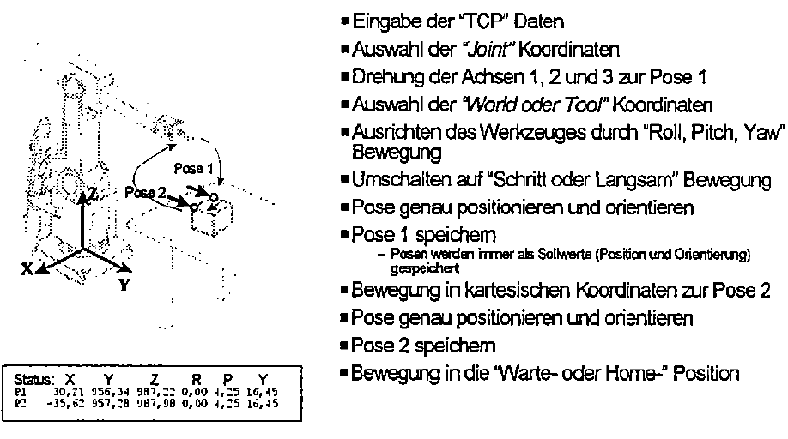
Pose Programming
Abstract task:
Enter the "TCP" data
Selection of the "Joint" coordinates
Rotation of axes 1, 2 and 3 to pose a
Choosing the "World or tool” coordinates
Align the tool with "Roll, Pitch, Yaw Movement
Switch to "Step or Slow Motion
Pose, exact position and orient
Pose 1 save
- Poses are always stored in set-point (position and orientation)
Motion in Cartesian coordinates to pose 2
Pose, position them and orient
Pose 2 save
Movement in the "wait-and-home" position
TEMPUS IV Project: 158644 – JPCR
Development of Regional Interdisciplinary Mechatronic Studies - DRIMS
ROBOTICS

Slide 23
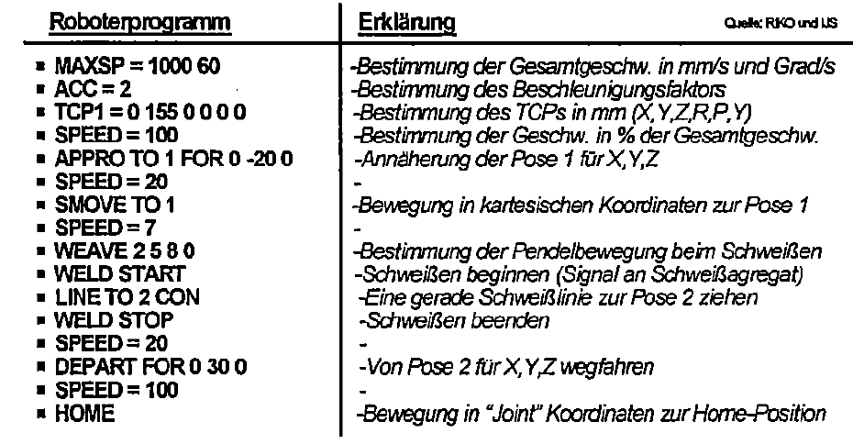
Programming functions and signal
Example of a program on a very simple but defined robot!
Robot program
Explanation
Determination of the total velocity in mm / s and degree / s
- Determination of the acceleration factor
- Determination of the TCPs in mm (X, Y, Z, R, P, Y)
- Determination of the rate in % overall speed
- Bringing the Pose 1 for X, Y, Z
-
Motion in Cartesian coordinates to Pose 1
-
Determination of the pendulum motion during welding
- Welding start (signal to welding device)
- A straight weld line to pull Pose 2
- Welding End
-
Move away from Pose 2 for X, Y, Z
- Movement in joint coordinates to the home position
TEMPUS IV Project: 158644 – JPCR
Development of Regional Interdisciplinary Mechatronic Studies - DRIMS
ROBOTICS

Slide 24
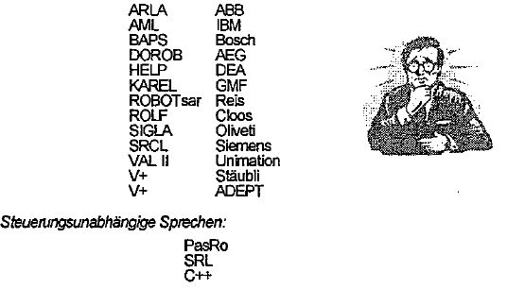
Programming Languages
Almost every robot has its own programming language!
Control independent language:
TEMPUS IV Project: 158644 – JPCR
Development of Regional Interdisciplinary Mechatronic Studies - DRIMS
ROBOTICS

Slide 25

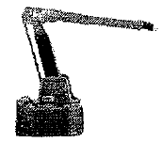
Play-Back Programming
- The operator uses the robot (or a device driver) directly.
- He leads the mechanism manually the task accordingly.
- During the movement the respective joint angle values can be read in a fixed time frame and stored.
Requirements:
- Kinematic balance
- Low friction in the joints
- Very high flexibility of movement
Advantages:
- Very easy programming
- No prior knowledge of the operator necessary
Disadvantages:
- Correction in difficult sections of path
- Difficult change of velocity
Source: Gorenje
Source: ABB
Primarily for the coating or glue-robot

Slide 26
Task of the sensors
Approach to the programming ease, flexibility and versatility
Important role SENSORS
Searching for objects or poses
Parts on an assembly line, seam beginning, seam edge, plate boundary, installation help ...
- Tracking contours or litigation
Seam tracking, editing, with constant force (brushes, polishing, grinding, ...)
Bending process pursue prosecution of Machine removal of parts ...
- Velocity fitting
Teaching at a standstill, performing the move (coating on the assembly line, ...)
TEMPUS IV Project: 158644 – JPCR
Development of Regional Interdisciplinary Mechatronic Studies - DRIMS
ROBOTICS

Slide 27
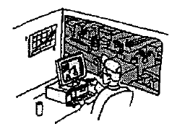
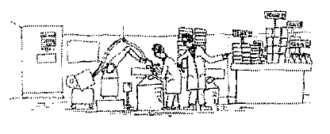
Off-Line Programming
What is Off-Line Programming?
When?
Why Off-Line Programming?
TEMPUS IV Project: 158644 – JPCR
Development of Regional Interdisciplinary Mechatronic Studies - DRIMS
ROBOTICS

Slide 28
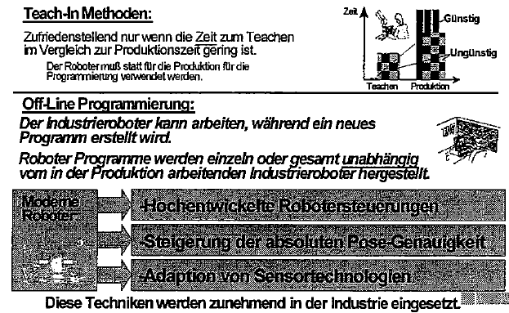
What is Off-Line Programming?
Teach-in methods:
Satisfactory only when the time for teaching in comparison to the production time is low.
The robot must be used instead for the programming for the production.
Off-Line Programming:
The robot can work, while a new program is created.
Robot programs are independent of the singly or in total produced in the production of industrial robots working.
Modern robot:
-Advanced Robot Controllers
-Increase of the absolute pose accuracy
-Adaptation of sensor technologies
These techniques are increasingly used in the industry.
TEMPUS IV Project: 158644 – JPCR
Development of Regional Interdisciplinary Mechatronic Studies - DRIMS
ROBOTICS

Slide 29
Off-line Programming
Programs can be developed without needing to use the robot
The sequence of operations and robot movements can be optimized or easily improved
Previously developed and tested procedures and subroutines can be used
External sensor data can be incorporated, though this typically makes the programs more complicated, and so more difficult to modify and maintain
Existing CAD data can be incorporated-the dimensions of parts and the geometric relationships between them, for example.
Programs can be tested and evaluated using simulation techniques, though this can never remove the need to do final testing of the program using the real robot
Programs can more easily be maintained and modified
Programs can more be easily properly documented and commented.
TEMPUS IV Project: 158644 – JPCR
Development of Regional Interdisciplinary Mechatronic Studies - DRIMS
ROBOTICS

Slide 30
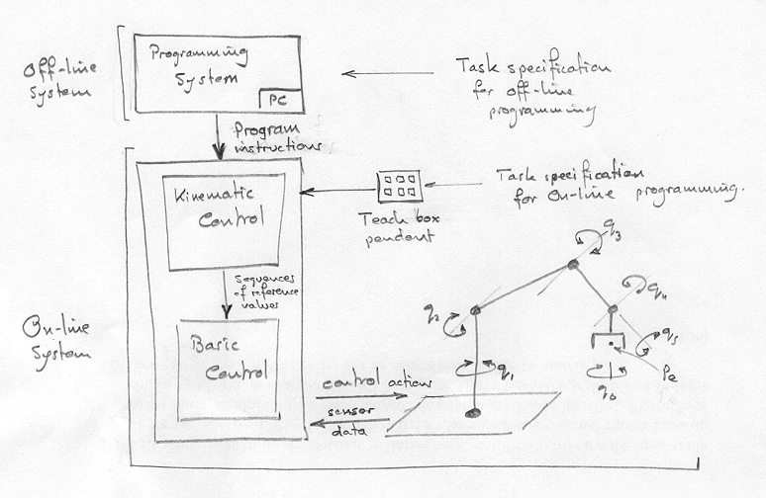
TEMPUS IV Project: 158644 – JPCR
Development of Regional Interdisciplinary Mechatronic Studies - DRIMS
ROBOTICS

Slide 31
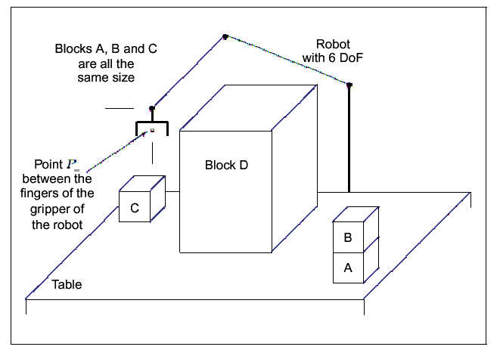
Robot Program Development
TEMPUS IV Project: 158644 – JPCR
Development of Regional Interdisciplinary Mechatronic Studies - DRIMS
ROBOTICS

Slide 32
Robot Program Development Process
Analyze and decompose the task into a series of operations on the objects involved, and specify their order.
Identify and specify all the situations needed to program all the movements and actions of the robot.
Identify any types of repeated actions or operations and specify them as subroutines with parameters.
Design and develop the complete robot program and its documentation.
Test and debug the program using a simulator of the robot and its work space.
Test the program on the real robot.
TEMPUS IV Project: 158644 – JPCR
Development of Regional Interdisciplinary Mechatronic Studies - DRIMS
ROBOTICS

Slide 33
Via Points!
TEMPUS IV Project: 158644 – JPCR
Development of Regional Interdisciplinary Mechatronic Studies - DRIMS
ROBOTICS

Slide 34
Why Off-Line Programming?
Teach-In - Time-consuming activity
- This increases with the complexity of the task
Teaching reduces the cost
- Robots can not produce during the Teachers
Robot in mass production
- Spot welding in automotive industry
- Does teach in new constitute a minimal effort
Robots in small and medium production
- Programming time can be considerably-
- Useful introduction of off-line programming
Increasing complexity of robot tasks
- Off-line programming can be very attractive
TEMPUS IV Project: 158644 – JPCR
Development of Regional Interdisciplinary Mechatronic Studies - DRIMS
ROBOTICS

Slide 35
Benefits of Off-Line Programming
Reduction of the robot operating time
Dislocation of both ends of the danger area of the robot
Single robot programming system
Integration of CAD / CAM systems
Simplification of complex tasks
Optimization of robot programs
Access control
Cycle time analysis
Verification of robot programs
TEMPUS IV Project: 158644 – JPCR
Development of Regional Interdisciplinary Mechatronic Studies - DRIMS
ROBOTICS

Slide 36
Off-Line Programming
OFF-LINE
Interactive
Explicit
Movement
Implicit
Task
TEMPUS IV Project: 158644 – JPCR
Development of Regional Interdisciplinary Mechatronic Studies - DRIMS
ROBOTICS

Slide 37
Now we can say:
Off-line programming is a significant increase in the productivity of the robot in the industry.
The main arguments for Off-Line system is the reduction of the overall robot use time by the overlap of the robot-programming with the actual robot work.
There are universal off-line programming systems, which allow the generation of robot program codes accessible for almost any industrial robot. In order to reduce their dependence start from a single robot.
TEMPUS IV Project: 158644 – JPCR
Development of Regional Interdisciplinary Mechatronic Studies - DRIMS
ROBOTICS

Slide 38
Type of Robot Programming
Joint level programming
  basic actions are positions (and possibly movements) of the individual joints of the robot arm: joint angles in the case of rotational joints and linear positions in the case of linear or prismatic joints.
Robot-level programming
  the basic actions are positions and orientations (and perhaps trajectories) of P_{e} and the frame of reference attached to it.
High-level programming
  Object-level programming
  Task-level programming
TEMPUS IV Project: 158644 – JPCR
Development of Regional Interdisciplinary Mechatronic Studies - DRIMS
ROBOTICS

Slide 39
Object Level Programming
basic actions are operations to be performed on the parts, or relationships that must be established between parts
pick-up part-A by side-A1 and side-A3
move part-A to location-2
pick-up part-B by side-B1 and side-B3
put part-B on-top-off part-A
with side-A5 in-plane-with side-B6 and
with side-A1 in-plane-with side-B1 and
with side-A2 in-plane-with side-B2
TEMPUS IV Project: 158644 – JPCR
Development of Regional Interdisciplinary Mechatronic Studies - DRIMS
ROBOTICS

Slide 40
Task Level Programming
basic actions specified by the program are complete tasks or subtasks
paint-the car-body red
assemble the gear-box
TEMPUS IV Project: 158644 – JPCR
Development of Regional Interdisciplinary Mechatronic Studies - DRIMS
ROBOTICS

Slide 41
Literature:
http://www.societyofrobots.com/robottheory/Survey_of_Robot_Programming_Systems.pdf
TEMPUS IV Project: 158644 – JPCR
Development of Regional Interdisciplinary Mechatronic Studies - DRIMS
ROBOTICS

